Slide 1
C++ Control Flow

Slide 2
C++ control structures
Selection
  if
  if . . . else
  switch
Repetition
  for loop
  while loop
  do . . . while loop

Slide 3
Loops
Branching
Condition
Statement
list
Condition
T
T
Statement
list
F
F

Slide 4
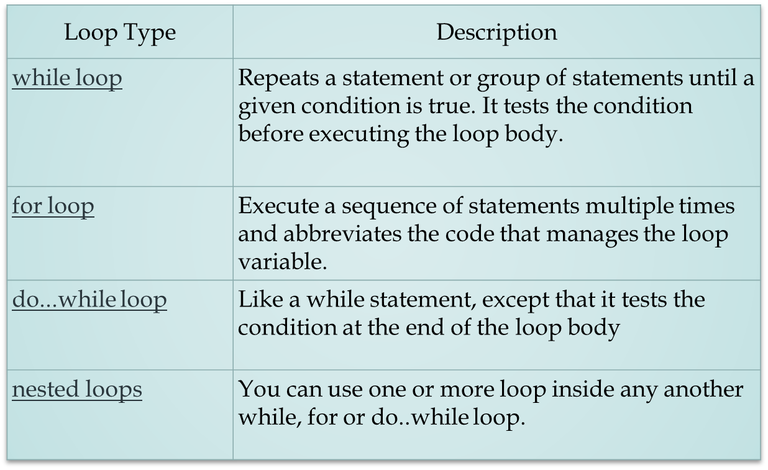
TYPES OF LOOPS
C++ programming language provides following types of loop to handle looping requirements:

Slide 5
CONTROL STRUCTURES
Use logical expressions which may include:
6 Relational Operators
< <= > >= == !=
3 Logical Operators
! && ||

Slide 6
Operator Meaning Associativity
! NOT Right
*, / , % Multiplication, Division, Modulus Left
+ , - Addition, Subtraction Left
< Less than Left
<= Less than or equal to Left
> Greater than Left
>= Greater than or equal to Left
== Is equal to Left
!= Is not equal to Left
&& AND Left
|| OR Left
= Assignment Right

Slide 7
“SHORT-CIRCUIT” EVALUATION
C++ uses short circuit evaluation of logical expressions
this means that evaluation stops as soon as the final truth value can be determined

Slide 8
Example
int Number;
float X;
( Number != 0) && ( X < 1 / Number )

Slide 9
Compound statement
We use braces {} to build compound - statements
To use braces or not to use braces??
for (i = 0; i < n; ++i)
sum += i;
for (i = 0; i < n; ++i) {
sum += i;
}

Slide 10
Conditional statements
Syntax
if (expression)
statement1
else
statement2
else clause is optional

Slide 11

Iteration statements
while-statement syntax
while (expression)
statement
semantics
It's a pre-test loop.

Slide 12
Iteration statements
// compute sum = 1 + 2 + ... + n
// using a while loop
int i;
int sum = 0;
i = 1;
while (i <= n) {
sum += i;
i++;
}
init of the lcv
loop termination condition.
body of the loop
incr of the lcv
Notes:
LCV Loop Control Variable

Slide 13
Iteration statements
// compute sum = 1 + 2 + ... + n
// using for loop
int sum = 0;
for (int i = 1; i <= n; ++i) {
sum += i;
}
i doesn't exist here!

Slide 14
while
Condition
Statement
list
while (Condition)
{
Statement list
}
T
F

Slide 15
Example while
Will there be any problem?
int no_times;
cout << “How many times do you want to say?”;
cin >> no_times;
while (no_times != 0)
{
cout << “Hello!” << endl;
no_times--;
}
cout << “End!!” << endl;
What if one inputs –1?
while (no_times > 0)

Slide 16
Example while
int a,b,sum;
cout << “This program will return the ”;
cout << “summation of integers from a to b.\n\n”;
cout << “Input two integers a and b:”;
cin >> a >> b;
while (a <= b)
{
sum += a;
a++;
}
cout << “The sum is ” << sum << endl;
sum = 0;
Don’t forget to set
sum = 0;
sum = sum + a;

Slide 17
do-while
string ans = “n”;
while (ans != “Y”)
{
cout << “Would you marry me?”;
cin >> ans;
}
cout << “Great!!”;
do
{
cout << “Would you like to continue?”;
cin >> ans;
} while (ans != “Y”);
cout << “Great!!”;
Statement
list
Condition
T
do
{
Statement list
} while (Condition);
F
; is required

Slide 18
Example 1: do-while
int i;
....
do
{
cout << “Please input a number between ”
<< “10 and 20:”;
cin >> i;
} while (i < 10 || i > 20);
......

Slide 19
The general format for a for loop
for (Initialization_action; Condition; Condition_update)
{
statement_list;
}
1
2
3
Factorial of n is n×(n-1)×(n-2)×...2×1
int n,f=1;
cin >> n;
for (i=2; i<=n; i++)
{
f *= i;
}
cout << “The factorial of ” << n << “ is ” << f << “.”;

Slide 20
Compare: for and while
for (Initialization_action; Condition; Condition_update)
{
statement_list;
}
for (Initialization_action; Condition; Condition_update)
{
statement_list;
}
1
2
3
int n,f=1;
cin >> n;
for (i=2; i<=n; i++)
{
f *= i;
}
cout << “The factorial of ” << n << “ is ” << f << “.”;
i=2;
while (i<=n)
{
f *= i;
i++;
}

Slide 21
Switch
switch (letter) {
case ‘N’: cout < “New York\n”;
break;
case ‘L’: cout < “London\n”;
break;
case ‘A’: cout < “Amsterdam\n”;
break;
default: cout < “Somewhere else\n”;
break;
}

Slide 22
JUMP STATEMENTS
The goto statement
A goto statement can transfer the program control anywhere in the program.
The target destination is marked by a label.
The target label and goto must appear in the same statement.
The syntax of goto statement is:
goto label;
…
label:

Slide 23
The break statement
The break statement enables a program to skip over part of the code.
A break statement terminates the smallest enclosing while, do-while and for statements.
A break statement skips the rest of the loop and jumps over to the statement following the loop.
The following figures explains the working of a break statement :

Slide 24

for(initialize;test expression;update)
{
statement1;
if(val>2000)
break;
:
statement2;
}
statement3;
WORKING OF BREAK STATEMENT IN FOR LOOP

Slide 25

while(test expression)
{
statement1;
if(val>2000)
break;
:
statement2;
}
statement3;
WORKING OF BREAK STATEMENT IN WHILE LOOP

Slide 26

do
{
statement1;
if(val>2000)
break;
:
statement2;
} while(test expression)
statement3;
WORKING OF BREAK STATEMENT IN DO-WHILE LOOP

Slide 27
The continue statement
The continue statement works somewhat like the break statement.
For the for loop, continue causes the conditional test and increment portions of the loop to execute. For the while and do...while loops, program control passes to the conditional tests.
Syntax:
The syntax of a continue statement in C++ is:
continue;

Slide 28
Nested loops (loop in loop)
b
*************
*************
*************
*************
cin >> a >> b;
for (int i = 0; i < a; i++)
{
for (int j=0; j<b; j++)
{
cout << “*”;
}
cout << endl;
}
a

Slide 29
Nested loops (2)
b
*
**
***
****
a
int a,b;
cin >> a >> b;
for (int i = 0; i < a; i++)
{
for (int j=0; j<b; j++)
{
if (j > i)
break;
cout << “*”;
}
cout << endl;
}

Slide 30
Nested loops (3)
b
*
**
***
****
a
int a,b;
cin >> a >> b;
for (int i = 0; i < a; i++)
{ for (int j=0; j<b && j < i; j++)
{
cout << “*”;
}
cout << endl;
}
if (j > i) break;
j <= i;

Slide 31
Scopes of Variables
0
loop in :: 1
loop end :: 3
loop in :: 4
loop end :: 6
7
Press any key to continue
int main()
{
........
........
int i=0;
cout << i << endl;
for (i = 1; i < 5; i++)
{
cout << "loop in :: " << i << endl;
i+=2;
cout << "loop end :: " << i << endl;
}
cout << i << endl;
return 0;
}

Slide 32
Nested Scopes
0
loop in :: 1
loop end :: 1
loop in :: 2
loop end :: 2
loop in :: 3
loop end :: 3
loop in :: 4
loop end :: 4
5
Press any key to
int main()
{
int i=0;
cout << i << endl;
for (i = 1; i < 5; i++)
{
cout << "loop in :: " << i << endl;
{
int i=3;
i+=2;
}
cout << "loop end :: " << i << endl;
}
cout << i << endl;
return 0;
}

Slide 33
Simple arrays
subscripts can be an integer expression
In the declaration, the dimension must be a constant expression
const int LENGTH = 100;
...
int a[LENGTH]
...
for (int i=0; i<LENGTH; i++)
a[i] = 0; // initialize array
known at compile time!

Slide 34
Functions:
3 parameter transmission modes
pass by value (default)
pass by reference (&)
pass by const reference (const &)
local copy
pass the address
good for big structures

Slide 35
Functions: example of pass by value
int sqr(int x) {
}
The compiler makes
a local copy!

Slide 36
The Swap Function
swap (a, b);
void swap(int x, int y)
{
// Create a temporary variable
int temp;
temp = x; The swap doesn’t
x = y; happen!
y = temp; Why?
}

Slide 37
Passing values by reference!
C/C++ passes parameters by value, i.e. a copy of the variable is passed to the function, not the actual value itself.
C++ can pass the actual variables themselves - known as passing parameters by reference.
To pass a parameter by reference we place & between the parameters type name and the parameter tag.

Slide 38
The New Swap Function
void swap(int& x, int& y)
{
// Create a temporary variable
int temp;
temp = x;
x = y;
y = temp;
}
What about functions and arrays / structures?

Slide 39
Arrays are passed by reference
#include <cstdlib.h>
const int MAX = 100;
void init(int a[], int x) {
for (int i = 0, i < MAX; ++i)
a[i] = rand() % 100; // remainder
x = 99;
}
main() {
int a[MAX], x = 7;
init(a, x);
cout << a[0] << “\t” << x << endl;
}

